Slide 1
Chapter 12 Mass-Storage Structure

Slide 2
教学内容、目标与要求
教学内容
磁盘结构
磁盘调度
磁盘管理
存储结构
教学重点
2、3
教学目标与要求
了解磁盘和磁带的物理结构；
理解并掌握磁盘调度算法；
了解磁盘格式化和启动块、坏块以及交换空间的管理。

Slide 3
Contents
12.1 Overview of Mass Storage Structure
12.2 Disk Structure
12.3 Disk Attachment
12.4 Disk Scheduling(√)
12.5 Disk Management
12.6 Swap-Space Management

Slide 4
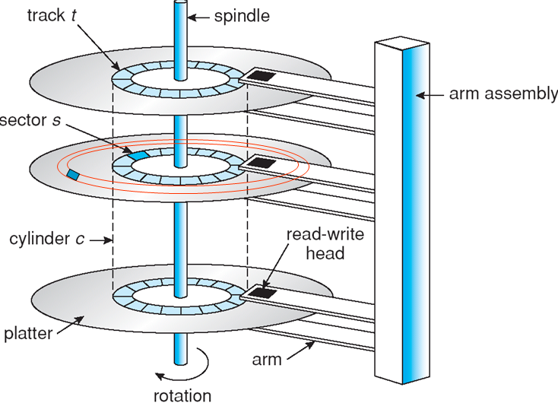
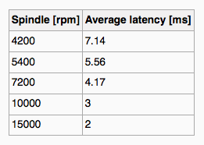
12.1 Overview of Mass Storage Structure
Magnetic disks provide bulk of secondary storage of modern computers
Hard Disks
Platters diameters: 3.5", 2.5", 1.8".
Capacity: from 30GB to 3TB.
Transfer Rate: theoretical, 6 Gb/sec. real: 1 Gb/sec.
Seek time: from 3ms to 12ms. 9ms common for desktop drives.
Average seek time measured or calculated based on 1/3 of tracks.
Latency based on spindle speed. Rotate 60 to 250 times per second. Average latency=1/2 latency.
120 rps
60*1000 / 7200 = 8.333

Slide 5
Hard Disk Performance
Transfer rate is rate at which data flow between drive and computer.
Positioning time (random-access time):
seek time, the time to move disk arm to desired cylinder.
rotational latency, the time for desired sector to rotate under the disk head.
Access Latency = Average access time = average seek time + average latency
For fastest disk, 3ms + 2ms = 5ms
For slow disk, 9ms + 5.56ms = 14.56ms

Slide 6
Hard Disk Performance
Average I/O time = average access time + (amount to transfer / transfer rate) + controller overhead.
E.g. Transfer a 4KB block on a 7200 rpm disk with a 5ms average seek time, 1Gb/sec transfer rate with a 0.1ms controller overhead.
Average I/O time = 5ms + 4.17ms + transfer time + 0.1ms = 9.27 ms + transfer time
transfer time = 4KB / 1Gb/s =4KB/(1/8*1024²KB/s) = 32 / (1024²) s = 0.031 ms
Average I/O time for 4KB block = 9.27ms +0 .031ms = 9.301ms

Slide 7
Overview of Mass Storage Structure
Head crash results from disk head making contact with the disk surface.
Cannot be repaired, the entire disk must be replaced.
Disks can be removable
generally consist of one platter, held in a plastic case to prevent damage while not in the disk drive.
Other forms: CDs, DVDs, and Blu-ray discs, flash drives.
A disk drive is attached to a computer via I/O bus.
advanced technology attachment (ATA), serial ATA (SATA), External Serial ATA (eSATA).
universal serial bus (USB)
fiber channel (FC)

Slide 8
Overview of Mass Storage Structure
Host controller in computer uses bus to talk to disk controller built into drive or storage array. E.g. To perform a disk I/O operation:
The computer places a command into the host controller, typically using memory-mapped I/O ports.
The host controller sends the command via messages to the disk controller.
The disk controller operates the disk-drive hardware to carry out the command.
Disk controllers have a built-in cache.
Data transfer at the disk drive happens between the cache and the disk surface.
Data transfer to the host, at fast electronic speeds, occurs between the cache and the host controller.

Slide 9
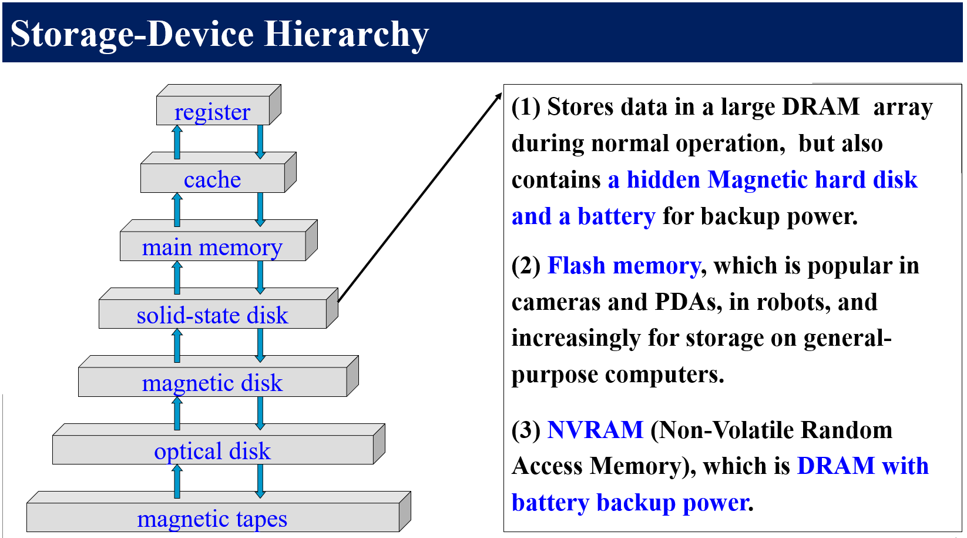
Solid-State Disks (SSD)
用固态电子存储芯片阵列制成。
由控制单元和存储单元组成。
存储介质：FLASH芯片、DRAM， 3D Xpoint (非易失；读取延时低，固态硬盘的百分之一；寿命长，接近无限。缺点：密度相对NAND较低，成本极高)
接口的规范和定义、功能及使用方法上与普通硬盘的完全相同，产品外形和尺寸上基本与普通硬盘一致。
Nonvolatile memory used like a hard drive
more reliable than HDDs, No moving parts
Faster than HDDs
no seek time or rotational latency
More expensive per MB
Consume less power
Less capacity
Maybe have shorter life span
Used in
storage arrays, where they hold file-system metadata that require high performance.
some laptop computers to make them smaller, faster, and more energy-efficient.
Standard bus can be too slow --> SSDs are designed to connect directly to PCI for example.

Slide 10
Magnetic tape
Was early secondary-storage medium
Relatively permanent and holds large quantities of data
Access time slow
Random access ~1000 times slower than disk
Mainly used for backup, storage of infrequently-used data, transfer medium between systems
Kept in spool and wound or rewound past read-write head
Once data under head, transfer rates comparable to disk
140MB/sec and greater
200GB to 1.5TB typical storage
Categorized by width, including 4, 8, and 19 millimeters and 1/4 and 1/2 inch.
Named according to technologies, LTO-5, SDLT.
Linear Tape Open
Super digital linear tape

Slide 11
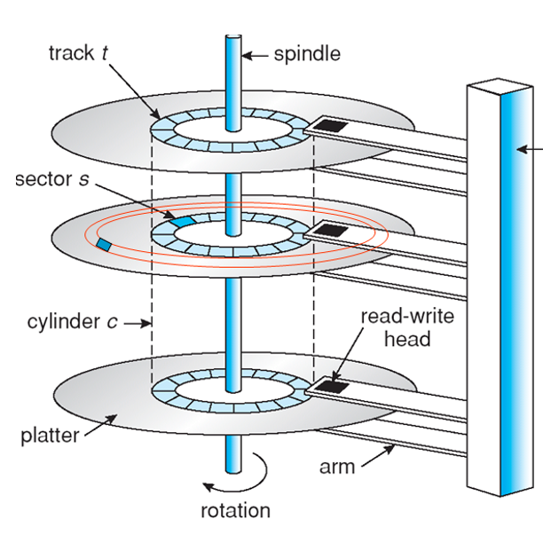
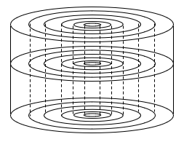

12.2 Disk Structure
Disk drives are addressed as large 1-dimensional arrays of logical blocks, where the logical block is the smallest unit of transfer.
Low-level formatting creates logical blocks on physical media.
block size is usually 512 bytes.
The 1-dimensional array of logical blocks is mapped into the sectors of the disk sequentially.
Sector 0 is the first sector of the first track on the outermost cylinder.
Mapping proceeds in order through that track, then the rest of the tracks in that cylinder, and then through the rest of the cylinders from outermost to innermost.

Slide 12
Disk Structure
Mapping logical to physical address should be easy
Except for bad sectors
Non-constant # of sectors per track via constant angular velocity
Constant Linear Velocity (常数线性周转率)
the density of bits per track is uniform.
Tracks in the outermost zone typically hold 40 percent more sectors than do tracks in the innermost zone.
CD-ROM, DVD-ROM
Constant Angular Velocity (常数角周转率)
the density of bits decreases from inner tracks to outer tracks.
hard disk

Slide 13
12.3 Disk Attachment
Computer access disk storage in two ways
Via I/O ports (host-attached storage)
Via a remote host in a distributed file system (NAS)

Slide 14
Host-attached storage
Is accessed through I/O ports talking to I/O busses
I/O bus architecture
IDE(Integrated Drive Electronics), ATA(Advanced Technology Attachment)
support maximum of 2 drives per I/O bus, Desktop PC
SATA (Serial ATA ), similar protocol, but simplified cabling.
SCSI (Small Computer System Interface), itself is a bus
up to 16 devices on one cable.
SCSI initiator (controller card in the host) requests operation and SCSI targets (storage devices) perform tasks
A SCSI disk is a common SCSI target
Each target can have up to 8 logical units (disks attached to device controller)

Slide 15
Host-attached storage
I/O bus architecture (Cont.)
FC (Fibre Channel), is a high-speed serial architecture, can operate over optical fiber or over a 4-conductor copper cable, two variants:
switched fabric with 24-bit address space – the basis of storage area networks (SANs) in which many hosts attach to many storage units
arbitrated loop (FC-AL，Fibre Channel Arbitrated Loop) of 126 devices
I/O directed to bus ID, device ID, logical unit (LUN)

Slide 16
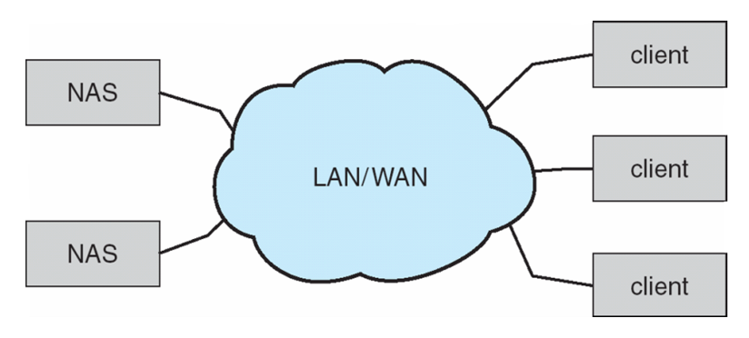
Network-Attached Storage (NAS)
NAS is a special-purpose storage, accessed remotely over a data network.
Clients access NAS via a RPC interface between host and storage. NFS and CIFS (Common Internet File System) are common protocols.
RPCs are carried via TCP or UDP on IP network.
The NAS unit is usually implemented as a RAID array with software that implements the RPC interface.
New iSCSI protocol uses IP network protocol to carry the SCSI protocol. Remotely attaching to devices (blocks)
缺点：存储I/O操作消耗数据网络上的 带宽，增加网络通信的延迟。

Slide 17
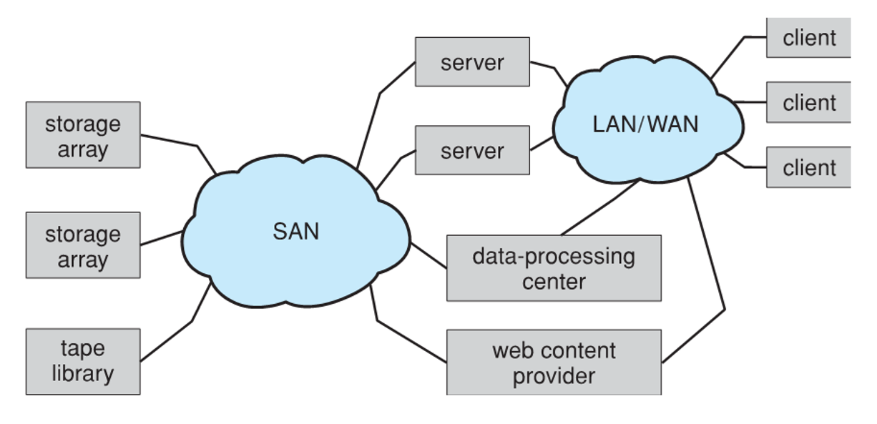
Storage Area Network (SAN)
Private network connecting servers and storage units, (FC switches) using storage protocols.
Common in large storage environments.
Multiple hosts attached to multiple storage arrays – using LUN, flexible
FC is the most common SAN interconnect.
The simplicity of iSCSI is increasing its use.
InfiniBand, a special-purpose bus architecture
provides hardware and software support for high-speed interconnection networks for servers and storage units.
优点：通过低延迟光纤通道结构，易于添加或删除存储、添加新主机并为其分配存储。

Slide 18
12.4 Disk Scheduling
The OS is responsible for using hardware efficiently.
for disk drives, means having a fast access time and disk bandwidth.
To read or write, the disk head must be positioned at the desired track and at the beginning of the desired sector.
Access time has two major components:
Seek time is the time for the disk arm to move the heads to the cylinder containing the desired sector. ( from 3ms to 12ms. )
Rotational latency is the additional time waiting for the disk to rotate the desired sector to the disk head. ( spindle speed. Avg. =1/2 latency)
Minimize seek time
Seek time ≈ seek distance
Disk bandwidth is the total number of bytes transferred, divided by the total time between the first request for service and the completion of the last transfer.

Slide 19
Disk Scheduling
There are many sources of disk I/O request
OS
System processes
Users processes
I/O request includes input or output mode, disk address, memory address, number of sectors to transfer.
OS maintains queue of requests, per disk or device.
Idle disk can immediately work on I/O request, busy disk means work must queue.
Optimization algorithms only make sense when a queue exists

Slide 20
Disk Scheduling
Disk drive controllers have small buffers and can manage a queue of I/O requests.
Several algorithms exist to schedule the servicing of disk I/O requests.
FCFS, SSTF, SCAN, C-SCAN, LOOK, C-LOOK
Example： a request queue with requests for I/O to blocks on cylinders (0-199): 98, 183, 37, 122, 14, 124, 65, 67
Head pointer 53.
Assume: It takes 0.5ms for the disk head to move past each cylinder.
Calculate：
The total number of cylinders that need to be moved.
The average time required to process an I/O request.

Slide 21
FCFS--First Come First Served
排队
queue = 98, 183, 37, 122, 14, 124, 65, 67
head starts at 53
0
14
37
53
65
67
98
122
124
183
199
total head movement of 640 cylinders. 0.5*640/8=40 ms

Slide 22
SSTF--Shortest Seek Time First
近者优先
效率，饥饿
Selects the request with the least seek time from the current head position.
queue = 98, 183, 37, 122, 14, 124, 65, 67
head starts at 53
0
14
37
53
65
67
98
122
124
183
199
Head movement of 236 cylinders. 0.5*236/8=14.75 ms
starvation

Slide 23
SCAN Scheduling
The disk arm starts at one end of the disk, and moves toward the other end, servicing requests until it gets to the other end of the disk, where the head movement is reversed and servicing continues.
Sometimes called the elevator algorithm.

Slide 24
SCAN
公平/效率
无饥饿
queue = 98, 183, 37, 122, 14, 124, 65, 67
head starts at 53, moving toward 199.
0
14
37
53
65
67
98
122
124
183
199
total head movement of 331 cylinders. 0.5*331/8=20.6875 ms

Slide 25
C-SCAN Scheduling— Circular SCAN
Provides a more uniform wait time than SCAN.
The head moves from one end of the disk to the other. servicing requests as it goes. When it reaches the other end, however, it immediately returns to the beginning of the disk, without servicing any requests on the return trip.
Treats the cylinders as a circular list that wraps around from the last cylinder to the first one.

Slide 26
C-SCAN
公平，无饥饿
queue = 98, 183, 37, 122, 14, 124, 65, 67
head starts at 53, moving toward 199
0
14
37
53
65
67
98
122
124
183
199
total head movement of 382 cylinders. 0.5*382/8=23.875

Slide 27
LOOK and C-LOOK Scheduling
Version of SCAN and C-SCAN
Arm only goes as far as the last request in each direction, then reverses direction immediately, without first going all the way to the end of the disk.

Slide 28
LOOK
公平/效率
queue = 98, 183, 37, 122, 14, 124, 65, 67
head starts at 53, moving toward 199.
0
14
37
53
65
67
98
122
124
183
199
total head movement of 299 cylinders. 0.5*299/8=18.6875ms

Slide 29
C-LOOK
公平/效率
queue = 98, 183, 37, 122, 14, 124, 65, 67
head starts at 53, moving toward 199
0
14
37
53
65
67
98
122
124
183
199
total head movement of 322 cylinders. 0.5*322/8=20.125

Slide 30
Disk-Scheduling Algorithm
algorithm | total number of cylinders | average time (ms)
FCFS | 640 | 40
SSTF | 236 | 14.75
SCAN | 331 | 20.6875
C-SCAN | 382 | 23.875
LOOK | 299 | 18.6875
C-LOOK | 322 | 20.125

Slide 31
Exercise 1
Suppose that a disk drive has 5000 cylinders, number 0 to 4999. The drive is current serving a request at cylinder 143, and the previous request was at cylinder 94. The queue of pending requests, in FIFO order, is: 86, 1470, 913, 1774, 948, 1509, 1022, 1750, 130
Starting from current position. If the total distance (in cylinders) that the disk arm moves to satisfy all the pending request is 9769, so what disk-scheduling algorithm may the system use? And why?

Slide 32
Answer to exercise 1
FCFS：143, 86, 1470, 913, 1774, 948, 1509, 1022, 1750, 130. 寻道距离：7081
SSTF：143, 130, 86, 913, 948, 1022, 1470, 1509, 1750, 1774. 寻道距离：1745
SCAN：143, 913, 948, 1022, 1470, 1509, 1750, 1774, 4999, 130, 86. 寻道距离：9769
C-SCAN：143, 913, 948, 1022, 1470, 1509, 1750, 1774, 4999, 0, 86, 130. 寻道距离：9985
LOOK：143, 913, 948, 1022, 1470, 1509, 1750, 1774, 130, 86. 寻道距离：3319
C-LOOK：143, 913, 948, 1022, 1470, 1509, 1750, 1774, 86, 130. 寻道距离：3356

Slide 33
Exercise 2
There is a disk drive which has 200 cylinders 0 through 199. The SCAN algorithm and SSTF algorithms are used to schedule the request queue. Consider a disk queue with requests for I/O to blocks on cylinders, 98, 182, 37, 122, 14, 65, 124, 67 and the disk head is initially at cylinder 53. Suppose these two algorithms result in a same total head movement of cylinders.
Question: Please describe the movement direction of the disk head when using the SCAN algorithms, which movement direction?

Slide 34
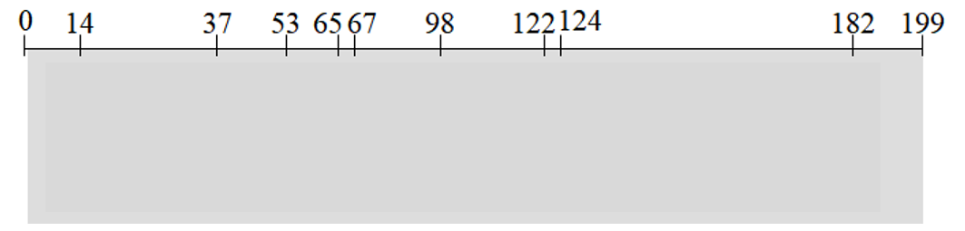
Answer to exercise 2
When SSTF algorithm is used
Scheduling order:
Head movement of cylinders.
When SCAN algorithm is used
If head is moving toward 199, Head movement of cylinders
If head is moving toward 0, Head movement of cylinders
So, When SCAN algorithm is used, head is moving toward 。

Slide 35
Exercise 3
There is a disk drive which has 200 cylinders 0 through 199. The SCAN algorithm algorithm is used to schedule the request queue. Consider a disk queue with requests for I/O to blocks on cylinders, 98, 182, 37, 122, 14, 65, 124, 67 Staring from the current head position, the SCAN algorithm is used to schedule the request queue, no matter which direction the disk head moves, the schedule algorithm results in a same total distance (in cylinders).
Which cylinder is the current head on? Why?

Slide 36
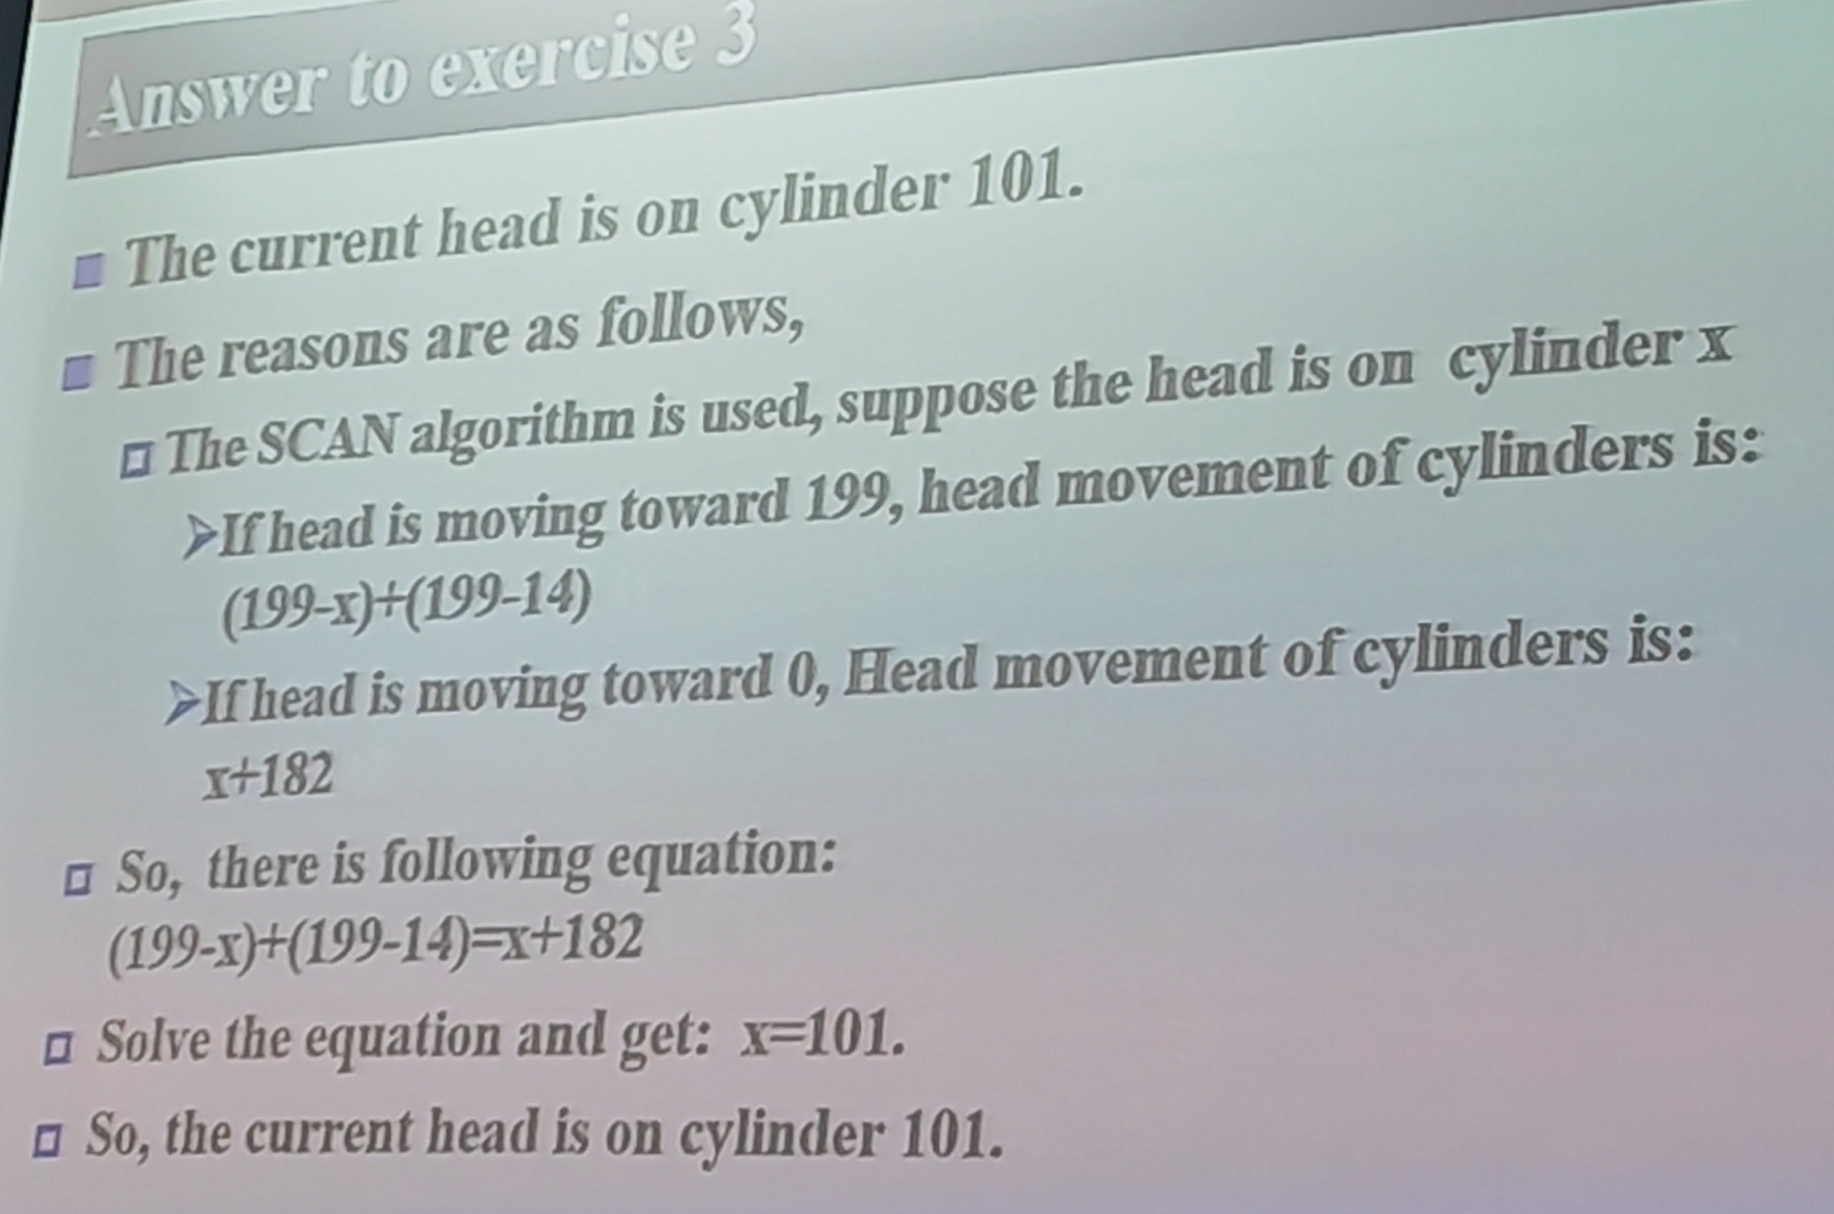
Answer to exercise 3
The current head is on cylinder .
The reasons are as follows,
The SCAN algorithm is used, suppose the head is on cylinder x
If head is moving toward 199, head movement of cylinders is:
If head is moving toward 0, Head movement of cylinders is:
So, there is following equation:
Solve the equation and get: x= .
So, the current head is on cylinder .

Slide 37
12.5 Disk Management
disk formatting
booting from disk
recovery from bad block

Slide 38
Disk formatting
Low-level formatting, or physical formatting — Dividing a disk into sectors that the disk controller can read and write.
Fills the disk with a special data structure for each sector.
The data structure typically consists of a header(sector #), a data area, and a trailer(ECC, error correction code).
Usually 512 bytes of data but can be selectable
To use a disk to hold files, the OS still needs to record its own data structures on the disk.
Partition the disk into one or more groups of cylinders. each treated as a logical disk.
Logical formatting or “making a file system”.
To increase efficiency most file systems group blocks into clusters
Disk I/O done in blocks
File I/O done in clusters

Slide 39
Disk Management
Raw disk access for apps that want to do their own block management, keep OS out of the way (databases for example).

Slide 40
Boot block
read only, needs no initialization, at a fixed location,
processor can start executing when powered up or reset.
Boot block initializes system
Initializes all aspects of the system, from CPU registers to device controllers and the contents of main memory, and then starts the operating system.
The bootstrap is stored in ROM.
The bootstrap program finds the OS kernel on disk, loads that kernel into memory, and jumps to an initial address to begin the operating-system execution.
Most systems store a tiny bootstrap loader program in the boot ROM.
The full bootstrap program is stored in a partition called the boot blocks, at a fixed location on the disk.
ROM
Boot block
System disk
Bootstrap loader
A full bootstrap program
Operating system
Instructs disk controller to read the contents into memory.

Slide 41
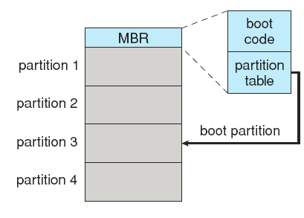
Booting from a Disk in Windows
Windows allows a hard disk to be divided into partitions
one partition, identified as the boot partition, contains the OS and device drivers.
Boot code in the first sector on the hard disk, terms MBR (master boot record).
Besides boot code, the MBR contains a partition table listing the partitions for the hard disk and a flag indicating which partition the system is to be booted from.
Booting begins by running code resident in the ROM.
Directs the system to read the boot code from the MBR.
Once the system identifies the boot partition, it reads the first sector (the boot sector) from that partition.
loading the various subsystems and system services.

Slide 42
Bad blocks
Controller calculates the ECC and finds the sector is bad.
Reports this finding to the operating system.
Methods used to handle bad blocks depends on the disk and controller in use.
An unrecoverable hard error results in lost data.
On simple disks, such as some disks with IDE controllers, bad blocks are handled manually.
format command, chkdsk command
For more sophisticated disks
methods such as sector sparing (or forwarding) are used to handle bad blocks.
most disks are formatted to provide a few spare sectors in each cylinder and a spare cylinder as well.
Some controllers can be instructed to replace a bad block by sector slipping.

Slide 43
12.6 Swap-Space Management
Swap-space, Virtual memory uses disk space as an extension of main memory.
Less common now due to memory capacity increases.
Swap-space can be carved out of the normal file system, or, more commonly, it can be in a separate disk partition (raw).
Swap-space Use
Swap-space Location
Swap-space management

Slide 44
Swap-space Use
Depending on the memory-management algorithms in use.
Use swap space to hold an entire process image.
Store pages that have been pushed out of memory.
The amount of swap space needed depends on:
the amount of physical memory,
the amount of virtual memory it is backing,
the way in which the virtual memory is used.
It may be safer to overestimate than to underestimate the amount of swap space required.
If a system runs out of swap space it may be forced to abort processes or may crash entirely.
Some systems recommend the amount to be set aside for swap space.
In the past, Linux, double the amount of physical memory.
Some systems allow multiple swap spaces.

Slide 45
Swap-space Location
A swap space can reside in one of two places:
Carved out of the normal file system, a large file
In a separate disk partition, raw partition
A large file
Normal file-system routines can be used to create it, name it, and allocate its space.
Easy to implement, but inefficient.
Raw partition
Swap-space storage manager, allocate and deallocate
A fixed amount of swap space is created during disk partitioning, adding more swap space requires repartitioning the disk.
Reinitialized at boot time.
Some OSs are flexible and can swap both in raw partitions and in file-system space.
Linux: the policy and implementation are separate
allowing the machine’s administrator to decide which type of swapping to use.

Slide 46
Swap-space management
4.3BSD allocates swap space when process starts; holds text segment (the program) and data segment.
Kernel uses swap maps to track swap-space use.
Solaris 2 allocates swap space only when a page is forced out of physical memory, not when the virtual memory page is first created.
File data written to swap space until write to file system requested.
Other dirty pages go to swap space due to no other home.
Text segment pages thrown out and reread from the file system as needed.

Slide 47
Data Structures for Swapping on Linux Systems

Slide 48

课后作业及研究性学习
作业
掌握磁盘调度算法
研究性学习
了解为大容量存储器提供的操作系统服务
国产存储产品调研，撰写调研报告。

